Slide 1

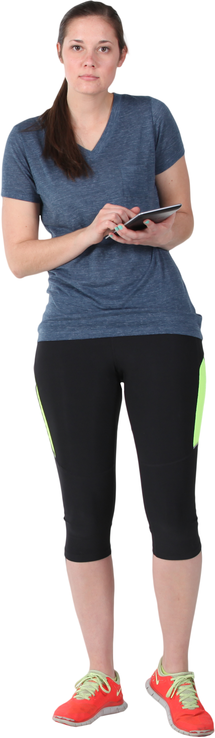







Addison
Age: 32
Profession: Sales manager
Status: Recently married
Household Income: $75k+
Children: None, but planning a family soon
Home: Owns home in a newer neighborhood
Interests
Likes staying fit, doesn’t like the gym
Getting away from technology after work
Working with her hands
Gardening
Little experience
New home in need of updated landscaping
Loves fresh cut flowers for the home

Slide 2
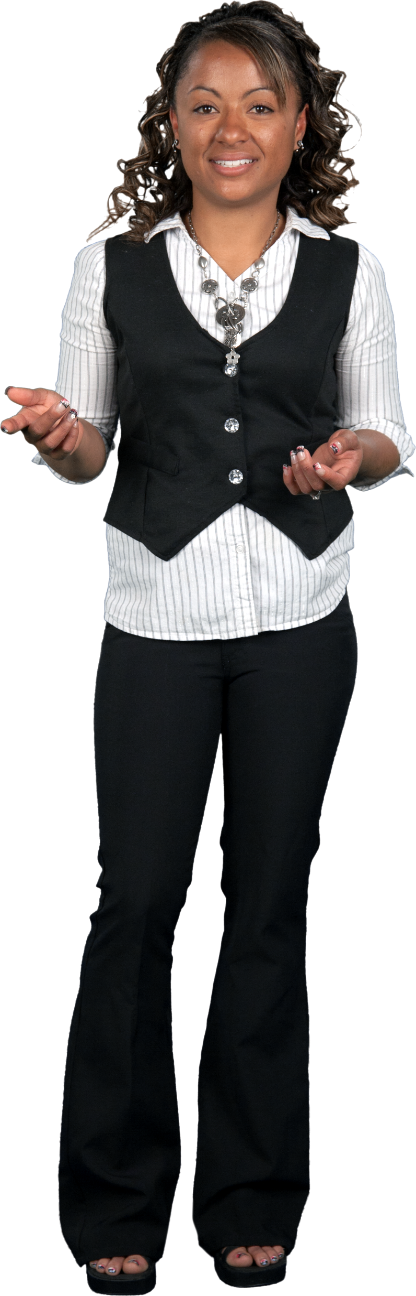
Sherri
Age: 26
Profession: Developer
Status: Engaged
Household Income: $60k+
Children: None
Home: Lives in an apartment
Interests
Volunteering
Hiking and exploring nature
Gardening
No previous experience
Looking for inspiration
Looking to help others create gardens
Interested in learning how to grow vegetables
Wants some indoor plants

Slide 3
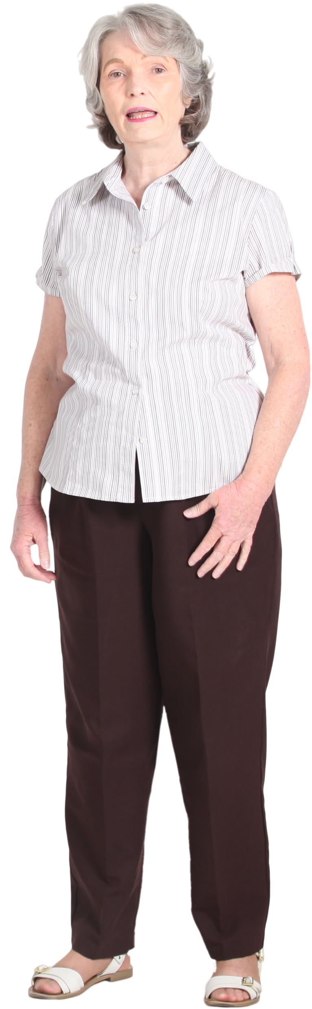
Rachel
Age: 62
Profession: Retires
Status: Married
Household Income: $125k+
Children: Two grandchildren 4 & 7
Home: Small home on a large lot
Interests
Staying active
Spending time outdoors
Spending time with the grandkids
Gardening
Experienced gardener
Likes sharing ideas for gardening
Changes the landscape often
Always looking for new ideas

Slide 4

Randy
Age: 59
Profession: Executive, nearing retirement
Status: Married
Household Income: $200k+
Children: Four, none at home
Home: Large suburban home & small farm
Interests
Preparing for retirement
Working his few acres on the farm
Gardening
Does the landscaping and maintenance for the home
Experience with shrubs and trees
Wants to grow fresh vegetables

